Slide 1
Characterization of Wild and Selectively Bred Oysters used in New England Aquaculture
Angel Carrasquillo* Rob Hudson, Dina Proestou, Tal Ben-Horin, Alexandra Moura,Kevin Ventriglia, Marta Gomez-Chiarri
University of Rhode Island alcarr@uri.edu

Slide 2
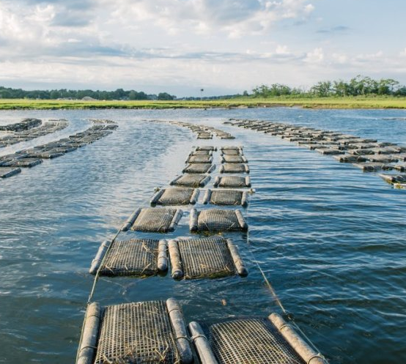
Oyster Aquaculture in New England
Eastern oysters (Crassostrea virginica) are one of the most farmed aquaculture species on the east coast of the U.S.
There is an increasing demand for half-shell oysters that will need to be met with aquaculture.

Slide 3
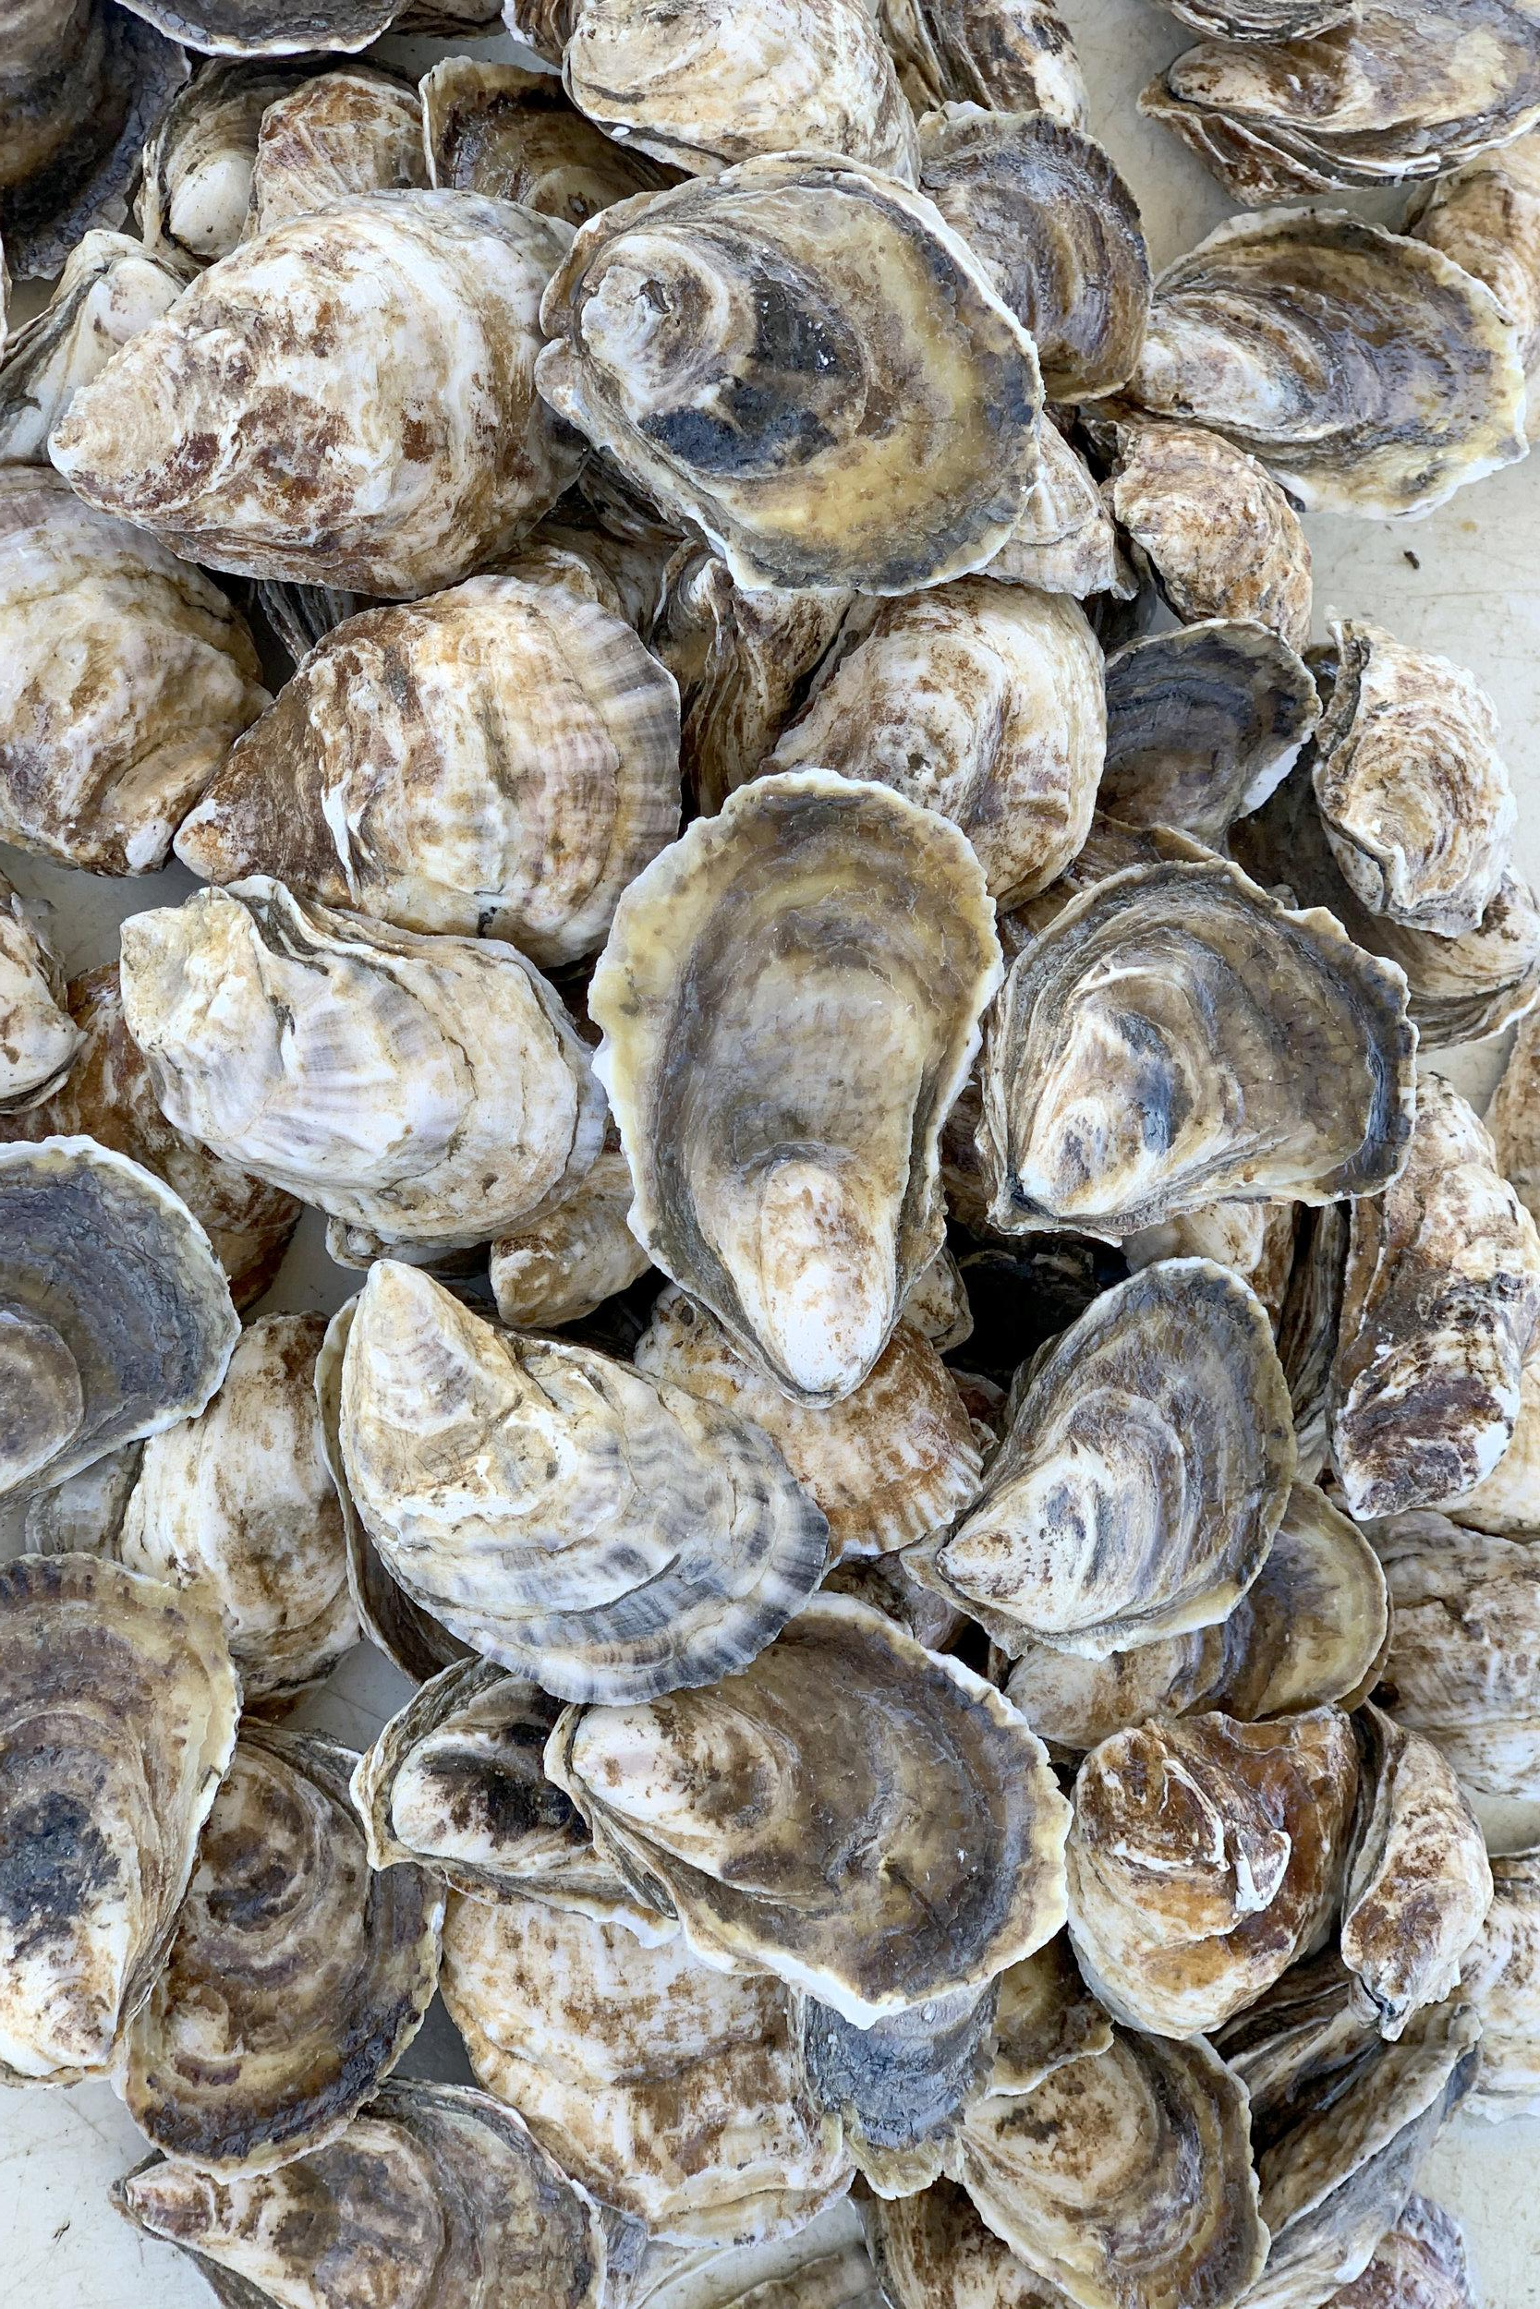
Environmental Challenges for Farmers
Ocean acidification
Marine heat waves
Pollution
Disease related mortality

Slide 4
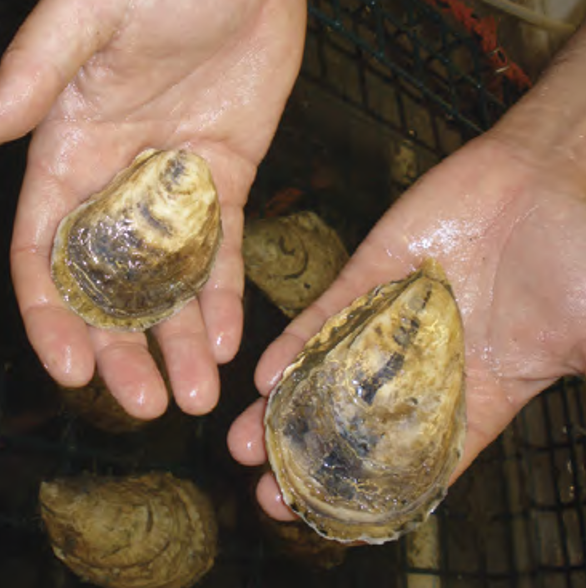
Selective Breeding of Oysters
Selective breeding on the eastern oyster has produced various commercial lines for use by farmers.
Oyster lines do not perform as well outside of the location where they were bred.
There is a need to establish breeding programs for different regions.
Notes:
GxE figure

Slide 5
How can we use genetic and phenotypic data to evaluate populations for breeding?

Slide 6
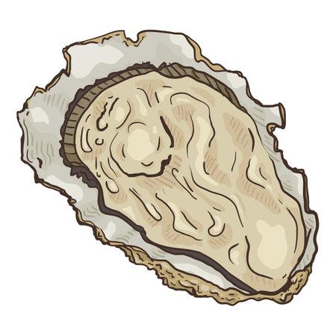
Considerations for Breeding
Performance:
Size: Shell length of oyster at harvest
Survival: Probability of living to harvest
Disease Tolerance/Resistance: Pathogen load and prevalence of pathogens.
Genetics:
Heterozygosity: Measure of genetic diversity
Inbreeding (Fis): Measure of how inbred individuals in a population are.
Genetic Differentiation (Fst): Measure of how different populations are from one another.
Notes:
Talk about why they are important

Slide 7
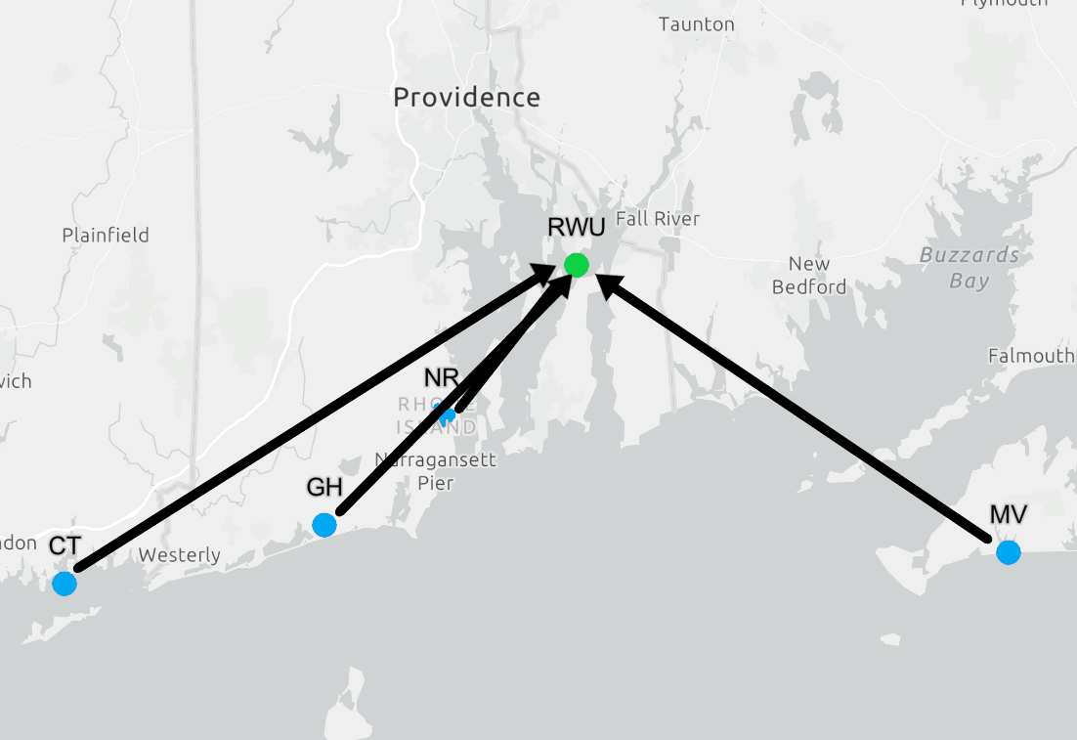
Experimental Design: Oyster Source Populations
Oysters from 4 wild populations and 2 commercial lines were collected and spawned under hatchery conditions.
Commercial Lines 1 and 2 (CL1 & CL2) are lines commonly used by growers across Southern New England

Slide 8
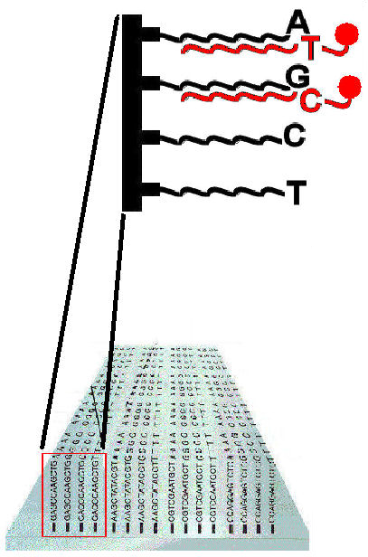
Genotyping
Broodstock oysters were genotyped on a 66K SNP array developed by Guo et al. 2023.
Poorly genotyped SNPs and individuals were removed from further downstream analysis.
Filtering Parameters (per population):
Individuals with < 5% missing data
SNPs with < 5% missing data
SNPs not significantly out of HWE (p < 1e-6)
SNPs with MAF > 5%
Only kept SNPs present in all populations after filtering

Slide 9
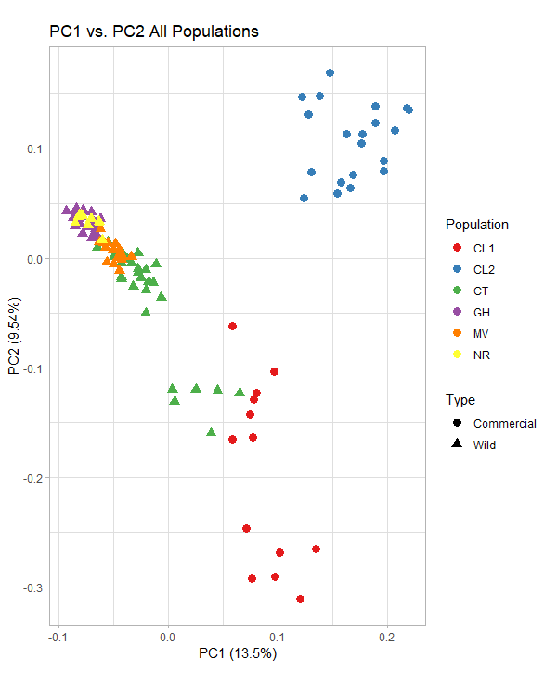
Principal Components Analysis (all populations)
After filtering 28,927 SNPs out of 65,983 were retained for further analysis.
The wild populations tend to cluster closer together than the commercial lines.
Notes:
Make sure to explain what the PCA represents (oysters with similar variation in SNP patterns are closer together in the plot

Slide 10
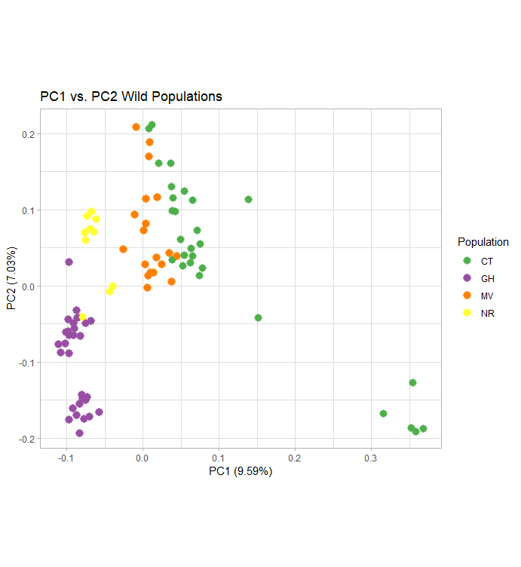
Principal Components Analysis (wild populations only)
Some of the individuals from each of the stocks cluster with individuals from other stocks.
CT oysters show more dissimilarity than the other stocks.

Slide 11
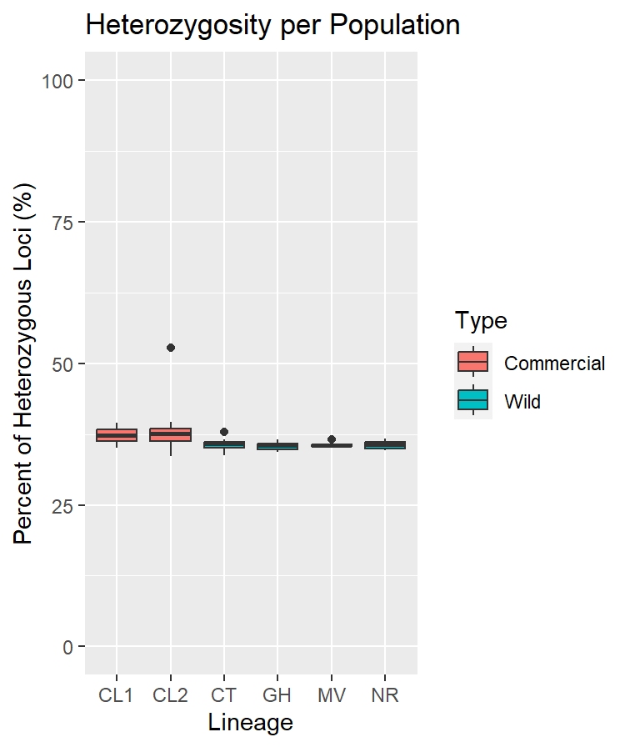
Heterozygosity Matches Previous Research in Oysters
Median Heterozygosity ranged from 35% to 37%
In Canada, oysters have heterozygosity between 28% and 29% (Bernatchez et al. 2019)
Commercially produced pacific oysters had heterozygosity between 35% and 65% (Liang et al. 2023)
N: 13 20 28 30 19 10
Notes:
Scale from 0 to 100

Slide 12
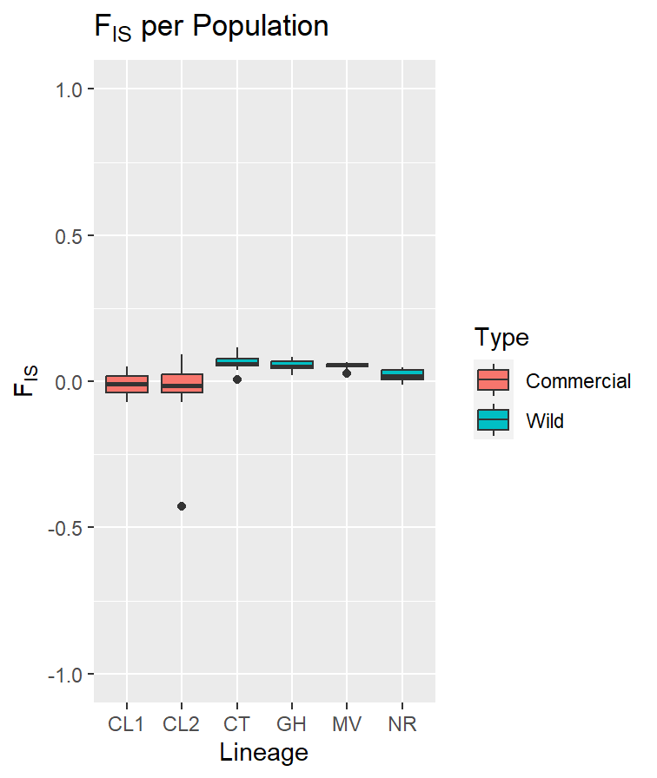
Inbreeding is Low
Median Fis ranged from -0.01 to 0.05
CL1, CL2 and NR were significantly less inbred than MV, GH and CT (Kruskall-Wallis Test p<0.05, Dunn Test, p<0.05)
In Canada, oysters have Fis values between 0.190 and 0.211 (Bernatchez et al. 2019)
N: 13 20 28 30 19 10

Slide 13
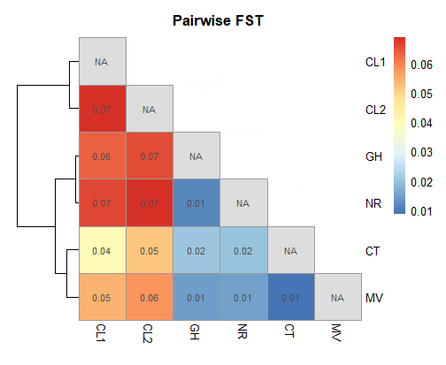
Populations Are Genetically Similar
Wild lines are genetically similar to each other.
None of these Fst values were significant (p<0.05).
Values ranged from 0.01 to 0.07.
Along the east coast of Canada Fst in oysters ranges from 0.0007 to 0.0228 (Bernatchez et al. 2019).

Slide 14
Considering All Metrics
Lineage | Size | Percent Survival | Inbreeding | Heterozygosity | Total
CL1 | 10 | 7 | 10 | 10 | 37
CL2 | 10 | 7 | 10 | 10 | 37
CT | 8 | 8 | 9 | 9 | 34
GH | 8 | 7 | 9 | 9 | 33
MV | 7 | 4 | 9 | 9 | 29
NR | 6 | 2 | 10 | 9 | 27

Slide 15
Conclusions
Both commercial lines had high performance and high genetic diversity.
CT was the best performing wild population.
Because of low pairwise Fst, not all wild populations need to be included in the regional breeding program.
For this study, CL1, CL2 and CT are the populations we would choose for breeding for Southern New England.
Future work will characterize:
Same stocks in different locations and years.
Different stocks from the Northeast region.

Slide 16
Acknowledgements
Collectors
Sam Ratcliff
Ximing Guo
Emma Green-Beach
Danielle Buttermore
USDA-ARS
Keegan Hart
Kathryn Markey-Lundgren
Seraphina Satkowski
Mary Sullivan
RWU
Abigail Scro
Roxanna Smolowitz
Undergraduate helpers in the shellfish hatchery

